Slide 1
Bump Mapping

Slide 2
Introduction
Let’s consider an example for which a fragment program might make sense
Mapping methods
  Texture mapping
  Environmental (reflection) mapping
    Variant of texture mapping
  Bump mapping
    Solves flatness problem of texture mapping
Angel: Interactive Computer Graphics 4E © Addison-Wesley 2005

Slide 3


Examples
Angel: Interactive Computer Graphics 4E © Addison-Wesley 2005

Slide 4
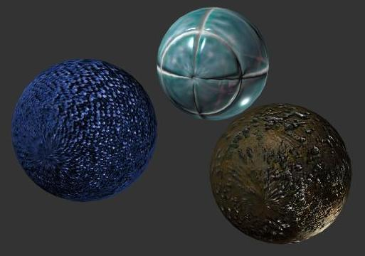
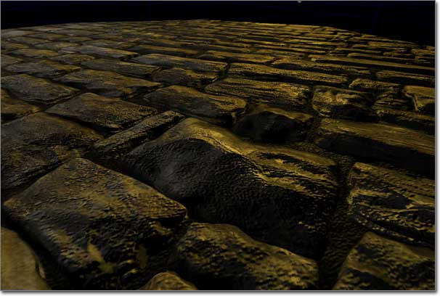
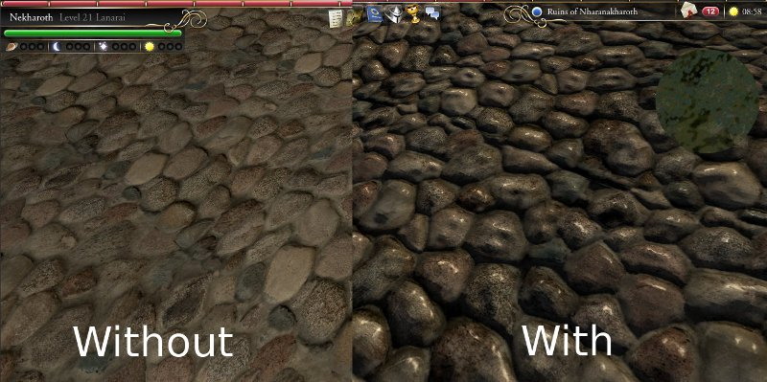
Angel: Interactive Computer Graphics 4E © Addison-Wesley 2005

Slide 5
Modeling an Orange
Consider modeling an orange
Texture map a photo of an orange onto a surface
  Captures dimples
  Will not be correct if we move viewer or light
  We have shades of dimples rather than their correct orientation
Ideally we need to perturb normal across surface of object and compute a new color at each interior point
Angel: Interactive Computer Graphics 4E © Addison-Wesley 2005

Slide 6
Bump Mapping (Blinn)
Consider a smooth surface
n
p
Angel: Interactive Computer Graphics 4E © Addison-Wesley 2005

Slide 7
Rougher Version
n’
p’
p
Angel: Interactive Computer Graphics 4E © Addison-Wesley 2005

Slide 8
Equations
p(u,v) = [x(u,v), y(u,v), z(u,v)]^{T}
p_{u}=[ ∂x/ ∂u, ∂y/ ∂u, ∂z/ ∂u]^{T}
p_{v}=[ ∂x/ ∂v, ∂y/ ∂v, ∂z/ ∂v]^{T}
n = (p_{u} × p_{v} ) / | p_{u} × p_{v} |
Angel: Interactive Computer Graphics 4E © Addison-Wesley 2005

Slide 9
Tangent Plane
p_{v}
n
p_{u}
Angel: Interactive Computer Graphics 4E © Addison-Wesley 2005

Slide 10
Displacement Function
p’ = p + d(u,v) n
d(u,v) is the bump or displacement function
|d(u,v)| << 1
Angel: Interactive Computer Graphics 4E © Addison-Wesley 2005

Slide 11
Perturbed Normal
n’ = p’_{u} × p’_{v}
p’_{u} = p_{u} + (∂d/∂u)n + d(u,v)n_{u}
p’_{v} = p_{v} + (∂d/∂v)n + d(u,v)n_{v}
If d is small, we can neglect last term
Angel: Interactive Computer Graphics 4E © Addison-Wesley 2005

Slide 12
Approximating the Normal
n’ = p’_{u} × p’_{v}
≈ n + (∂d/∂u)n × p_{v} + (∂d/∂v)n × p_{u}
The vectors n × p_{v} and n × p_{u} lie
in the tangent plane
Hence the normal is displaced in the tangent plane
Must precompute the arrays ∂d/ ∂u and ∂d/ ∂v
Finally,we perturb the normal during shading
Angel: Interactive Computer Graphics 4E © Addison-Wesley 2005

Slide 13
Image Processing
Suppose that we start with a function d(u,v)
We can sample it to form an array D=[d_{ij}]
Then ∂d/ ∂u ≈ d_{ij} – d_{i-1,j}
and ∂d/ ∂v ≈ d_{ij} – d_{i,j-1}
Embossing: multipass approach using accumulation buffer
Angel: Interactive Computer Graphics 4E © Addison-Wesley 2005

Slide 14
How to do this?
The problem is that we want to apply the perturbation at all points on the surface
Cannot solve by vertex lighting (unless polygons are very small)
Really want to apply to every fragment
Can’t do that in fixed function pipeline
But can do with a fragment program!!
Angel: Interactive Computer Graphics 4E © Addison-Wesley 2005

Slide 15
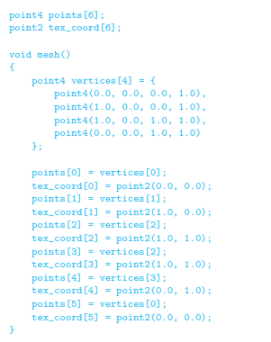
Angel: Interactive Computer Graphics 4E © Addison-Wesley 2005

Slide 16
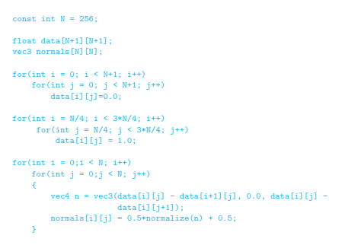

Angel: Interactive Computer Graphics 4E © Addison-Wesley 2005

Slide 17
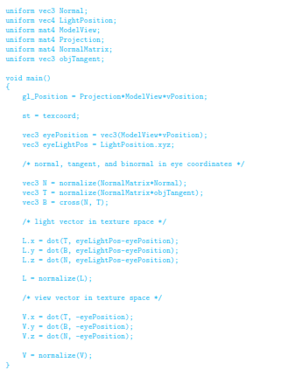
Angel: Interactive Computer Graphics 4E © Addison-Wesley 2005

Slide 18
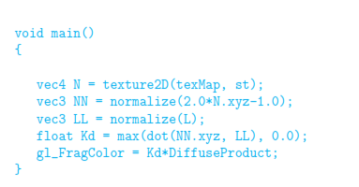
Angel: Interactive Computer Graphics 4E © Addison-Wesley 2005

